Slide 1
A HISTORY OF SUDDEN CARDIAC DEATH
The Role of the Autonomic Nervous System Anish Shah MD
February 18, 2019

Slide 2
“Why did he die on Tuesday and not on Monday?”
~ Douglas Zipes

Slide 3
OBJECTIVES
Understand how the ventricular substrate is affected by psychological triggers, which are modulated by the autonomic nervous system, leading to ventricular tachycardia and ventricular fibrillation.

Slide 4
ROAD MAP
Ventricular substrate
History
Story of sudden cardiac death
Autonomic modulation
Heart rate variability
Triggering sudden death
Autonomic risk
Notes:
Have this on the handout, include timeline, include references

Slide 5
What do we know about sudden death?
Complications of an MI
VF arrest is sent to the cath lab
ICD are placed for low EF

Slide 6
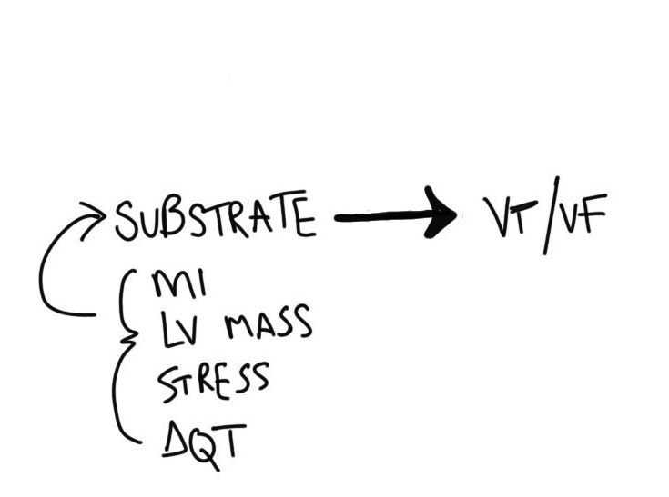
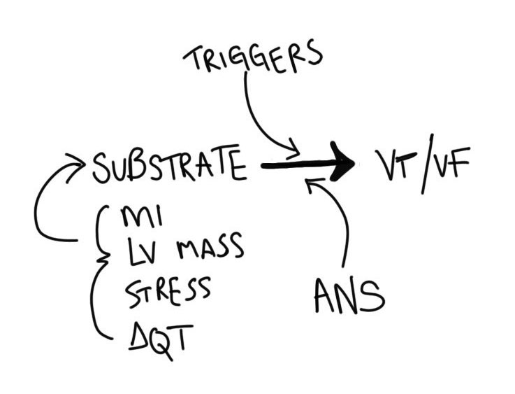
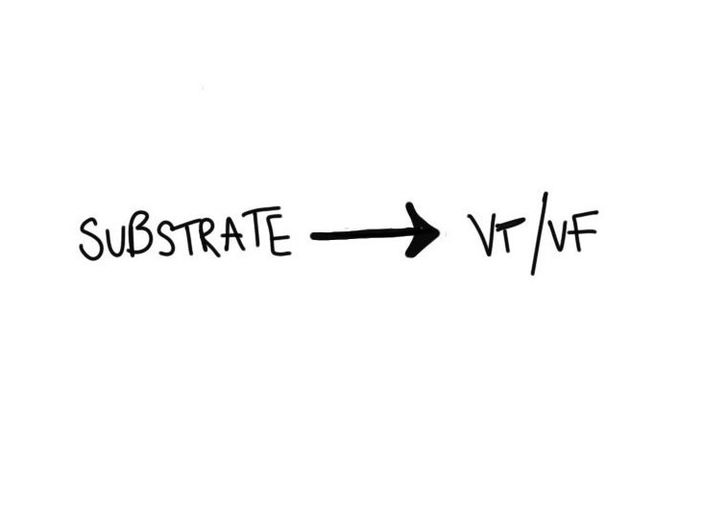
A model of sudden cardiac death
Notes:
Discuss distal innervation, Zipes work, sympathetic hyperinnervation after infarct

Slide 7
VENTRICULAR SUBSTRATE

Slide 8
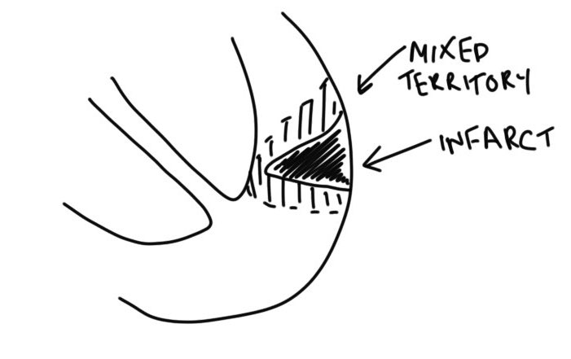
Ischemia
Notes:
Discuss distal innervation, Zipes work, sympathetic hyperinnervation after infarct

Slide 9
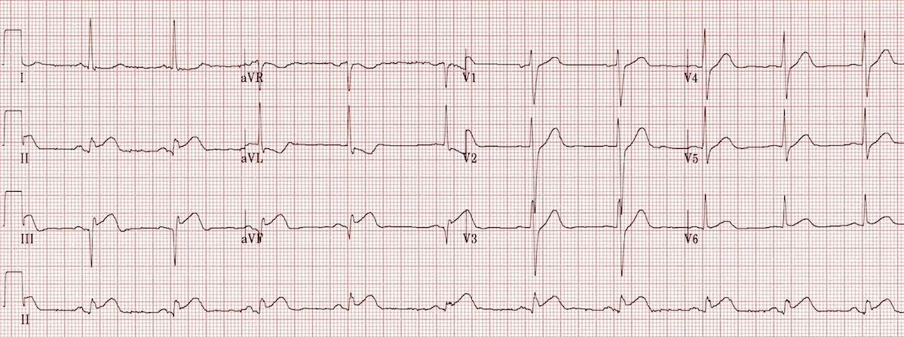
Differential innervation
Notes:
Bradycardia and vagal tone (cardiac afferents in teh inferior ventricular wall)

Slide 10
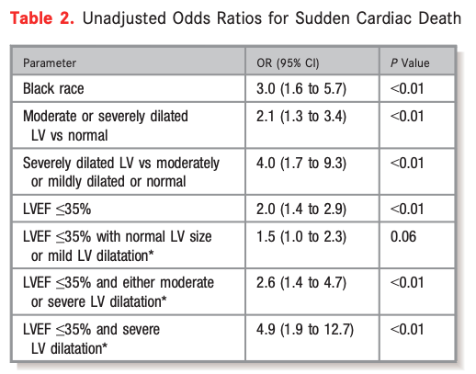
LV size
Shenasa 2017
Notes:
include work about LV size > 4 cm needed

Slide 11
HISTORY

Slide 12
John MacWilliam
VF proposed as cause of SCD in 1889:
fatal syncope
delirium cordis
circus contraction
intervermiform movement
Notes:
discuss cardiac tetany ludwig institute, home of Fick, Pavlov

Slide 13
The first defibrillation
Claude Beck performed the first successful human defibrillation in 1947
Notes:
discuss the fact that 1947 Beck performed first VF defibrillation This was done a 14 year old boy 45 minutes of cardiac massage (open chest) before countershock

Slide 14
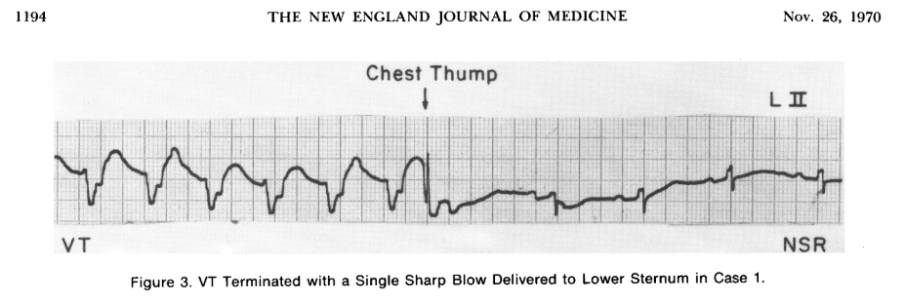
Precordial thump
Pennington et al 1970
Notes:
into the 1970s now

Slide 15
Precipitating death
Threat, grief, arousal, personal danger, reunion precede sudden death… 8 cases, 1971
Anxiety/anger precipitated SCD in depressed factory workers… 26 cases, 1972
Increased life stress precedes SCD by several months… 226 cases, 1973
Engel 1971; Greene et al 1972; Rahe et al 1973
Notes:
Anecdotes of events of threat, grief, arousal, mourning, personal danger, reunion precede sudden death.(Engel, 1971)
In an industrial plant in Rochester, NY, there were 26 reported cases of sudden death. Interviews with family noted that these individuals had been depressed over the past several weeks, and the events happened in the setting of acute arousal, either through increased work, anxiety, or anger.(Greene, Goldstein, & Moss, 1972)
Increasing stress has been shown to precede SCD,(Rahe, Bennett, Romo, Siltanen, & Arthur, 1973) and when measured in patients with ICD, VT and VF showed a similar pattern.(Lampert et al., 2002; Peter Taggart, Boyett, Logantha, & Lambiase, 2011)
The events also follow a circadian rhythm. Peak events of MACE occur from 6 AM to 10 AM, followed by a secondary peak of events from 6 PM to 8 PM.(Boudreau, Dumont, Kin, Walker, & Boivin, 2011; Muller, 1999; Portaluppi et al., 2012)

Slide 16
STORY OF SUDDEN DEATH

Slide 17
Advent of the CCU
Dr. Bernard Lown was an advocate:
restful rooms
cardiac monitoring and nurses
arrhythmia management (chemical and electrical)
Mortality prior >30%, and after <20%
Lown & Selzer 1968
Notes:
has been around since mid 1960s CCU and bernie lown 70-90% post-MI have ventricular extrasystole Bernie Lown proposed CCU would reduce mortality after myocardial ischemia Premises: restful rooms, cardiac monitoring, cardiac nurses, arrhythmia prophylaxis Reduced mortality >30% to <20%

Slide 18
Ideas behind sudden death
Mechanism of SCD is VF
Electrical instability precedes catastrophe
Ventricular beats predispose the vulnerable heart to VT/VF
Transient nervous risk factors induce electrical instability
Lown, Verrier, and Rabinowitz 1978

Slide 19
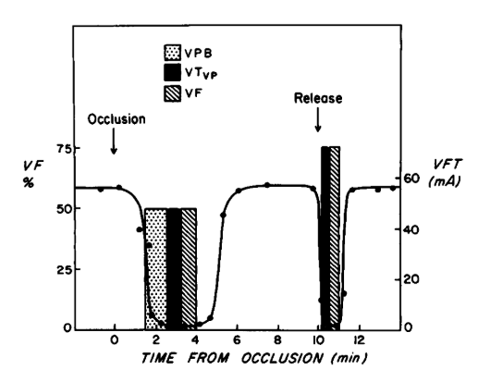
VF threshold
Bleich et al 1976

Slide 20
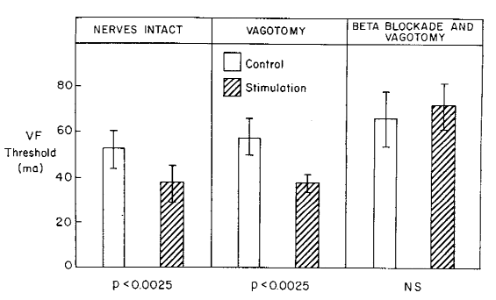
Changing VFT by hypothalamic stimulation
Verrier, Calvert, and Lown 1975

Slide 21
AUTONOMIC MODULATION

Slide 22
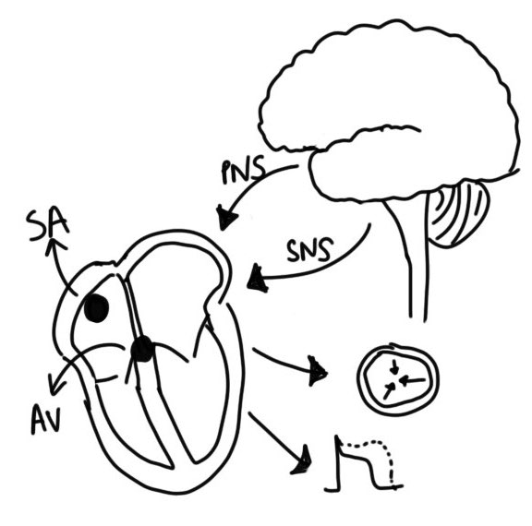
Neurocardiac axis
Notes:
drawing of the neurocardiac axis talk about role of ANS on heart, subsequent changes to repolarization and coronary vasomotor tone
Intrinsic cardiac ganglia Intrathoracic extracardiac ganglia CNS (medulla, spinal column)

Slide 23
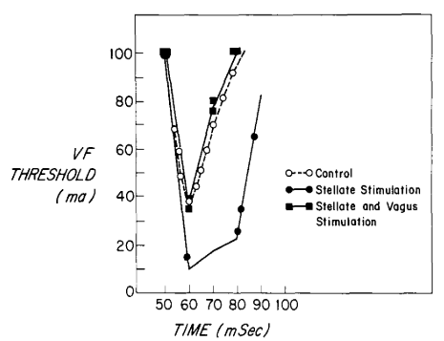
Stellate and vagal stimulation on VFT
Kolman, Verrier, and Lown 1975

Slide 24
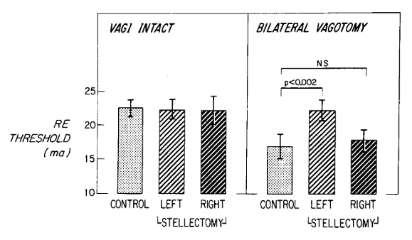
Stellectomy and vagotomy on VFT
Schwartz, Verrier, and Lown 1977

Slide 25
HEART RATE VARIABILITY

Slide 26
What is HRV?
The variability in between each beat:
Geometric domain
Non-linear domain
Frequency domain
The final integration of sympathovagal balance on the SA node.

Slide 27
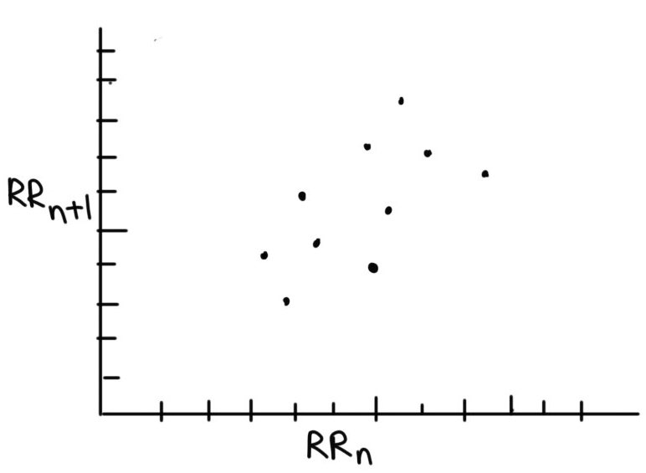
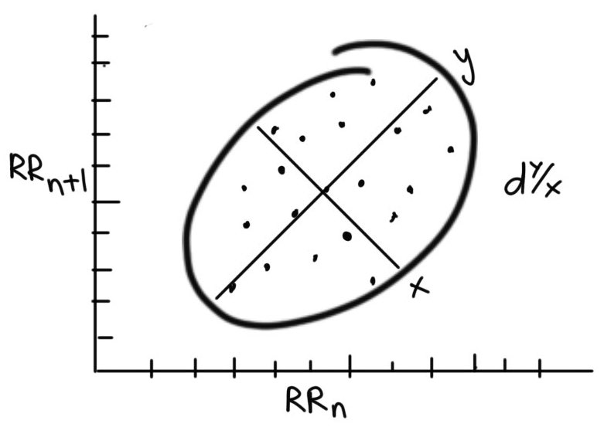
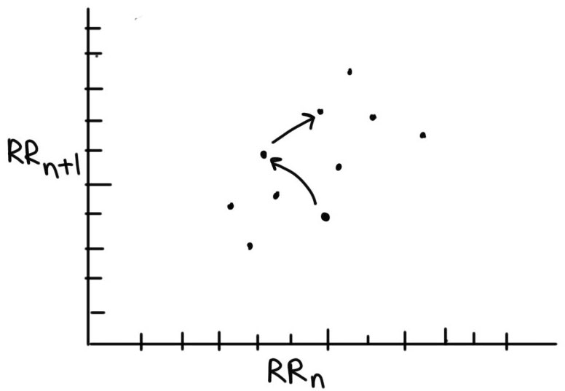
Poincaré plot
Notes:
explain that heart rate is also dependent on vagal/sympathetic tone

Slide 28
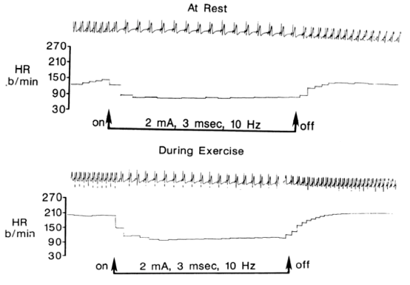
Accentuated antagonism
Stramba-Badiale et al 1991
Notes:
explain that heart rate is also dependent on vagal/sympathetic tone
Parasympathetic tone is fast/quick/strong

Slide 29
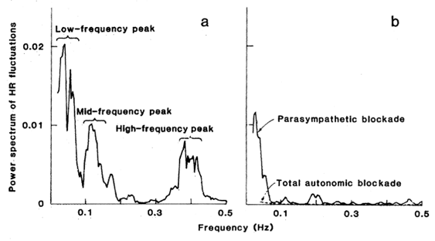
Power spectral analysis
Akselrod et al 1981
Notes:
go over akselrod paper talk about fourier transformation

Slide 30
TRIGGERING SUDDEN DEATH

Slide 31
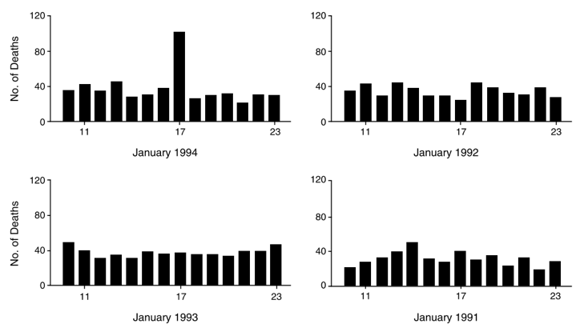
Northridge earthquake
Leor et al 1996

Slide 32
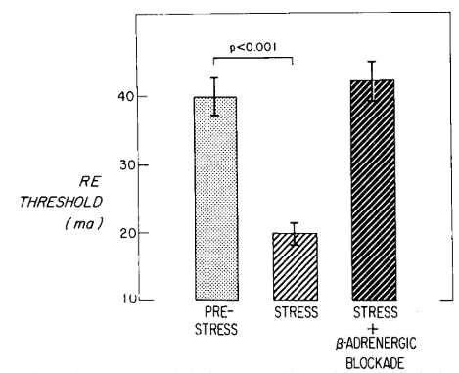
VF threshold
Lown et al 1977

Slide 33
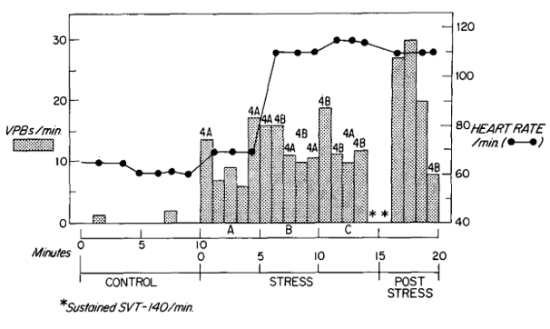
Frequency of PVCs
Lown et al 1977

Slide 34
AUTONOMIC RISK

Slide 35
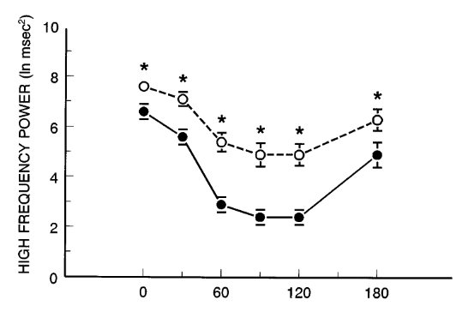
Canine model of VF susceptibility
Houle & Billman 1981

Slide 36
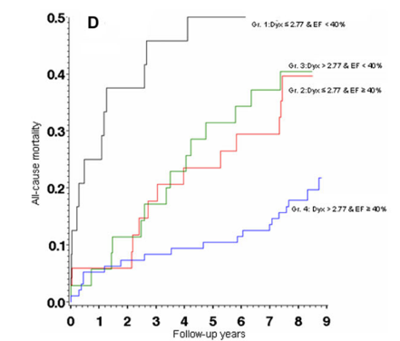
Dyx and mortality
Jørgensen et al 2016

Slide 37
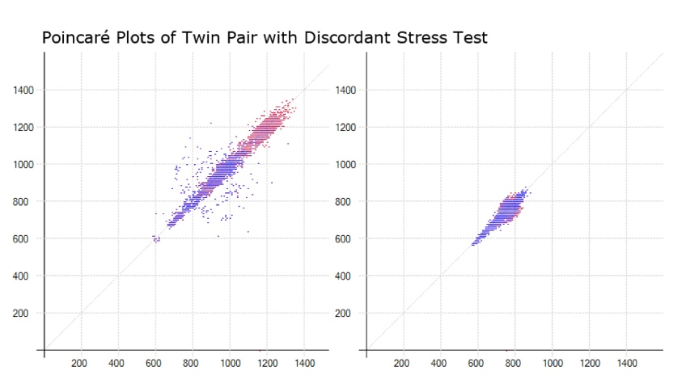
Poincaré and ischemia

Slide 38
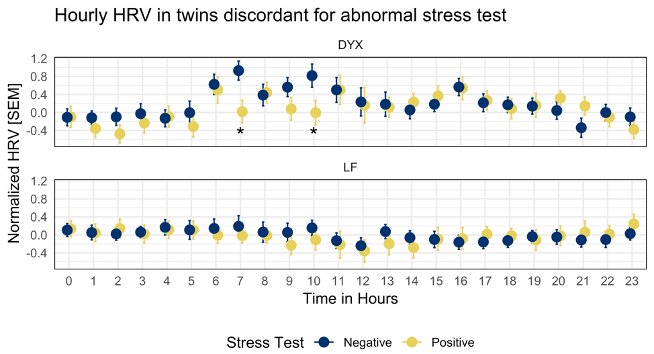
Circadian decreases in HRV

Slide 39
THANK YOU

